Slide 1
UNIT 2 CLASSES and OBJECTS in C++[8hrs]
Presented by
Er. Harendra Bikram Shah
(Lecturer)
Department of Computer Engineering

Slide 2
OUTLINES
Introduction to C++: Origin of C++, Basic C++ Program Structure, Console Input/output Streams and Manipulators
Structure in C and C++
Classes and Objects
Array of Objects
Class Diagram and Object Diagram
Access Specifiers and Visibility Mode
State and Behavior, Methods and Responsibilities
Implementation of Data Abstraction, Encapsulation, Message Passing and Data Hiding
Memory Allocation for Objects
Constructor: Default Constructor, Parameterized Constructor, Copy Constructor
Constructor Overloading
Destructors
Dynamic Memory Allocation: new and delete.
Dynamic Constructor
Functions: Inline function, Default argument, Passing and Returning by Value, Pointer and Reference, Static Data Member and Static Member Function
Friend Function and Friend Class

Slide 3
INTRODUCTION TO C++
C++ is a powerful and versatile High level programming language
Extension of the C programming language.
It was created by Bjarne Stroustrup (B-yar-ne Strov-stroop) in the early 1980s.
combines both procedural and object- oriented programming paradigms
Not a Pure OOPL

Slide 4
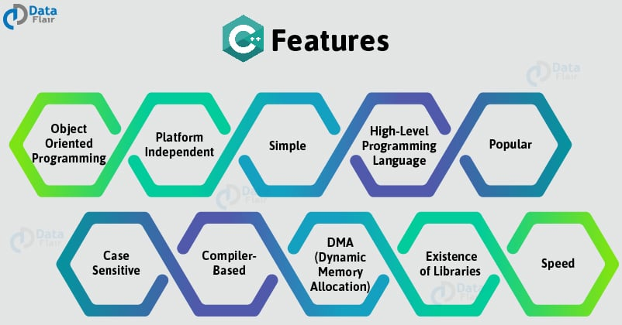
FEATURES OF C++

Slide 5

ORIGIN/HISTORY OF C++

Slide 6
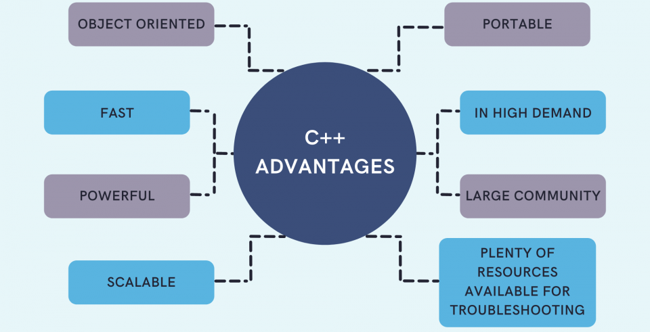

Slide 7
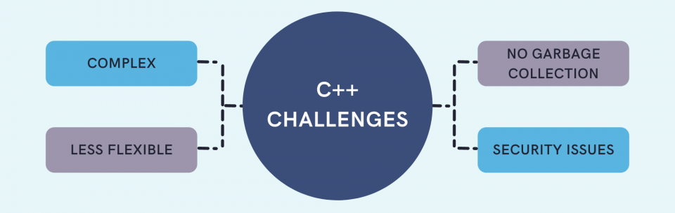

Slide 8
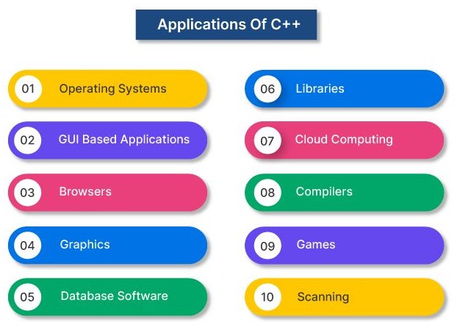

Slide 9
BASIC STRUCTURE OF C++
Preprocessor Directives:
#include for including header files and
#define for defining constants.
Main Function:
which serves as the entry point of the program. Execution starts from this function.
Function Declarations and Definitions:
Function declarations specify the function's name, return type, and parameters.
Statements and Expressions:
Statements are individual instructions or commands, while expressions produce a value when evaluated.
Variables and Data Types:
C++ supports various built-in data types such as int, float, char, bool, etc.
Control Flow:
Common control flow statements include if, else, switch, while, for, etc.
Input and Output:
cin and cout, for reading input from the user and displaying output to the screen, respectively.
use the extraction (>>) and insertion (<<) operators with these streams.
8. Return Statement:
At the end of the main() function, you typically include a return statement to indicate the termination of the program.

Slide 10
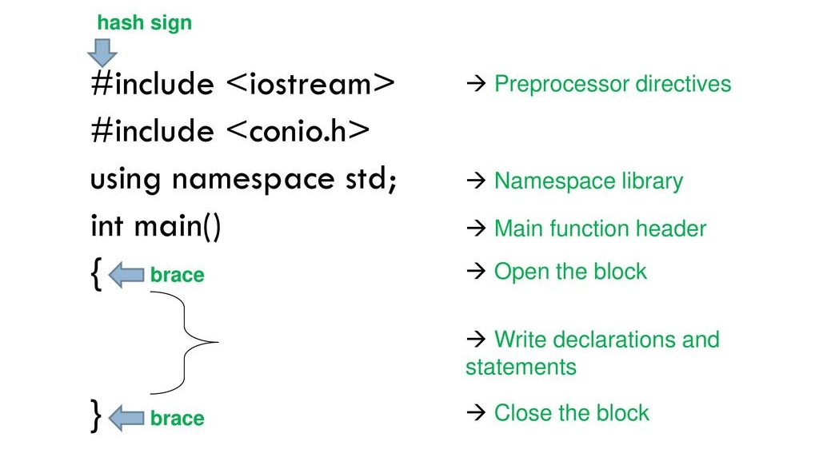
BASIC STRUCTURE OF C++

Slide 11
CONSOLE INPUT/ OUTPUT STREAMS
The standard input stream (`cin`) is used for reading input from the user,
while the standard output stream (`cout`) to display output to user
Output using `cout`:
2. Input using `cin`:
#include <iostream>
int main() {
int num;
std::cout << "Enter a number: "; std::cin >> num;
std::cout << "You entered: " << num << std::endl; return 0;
}
#include <iostream>
int main() {
int num = 42;
std::cout << "The value of num is: " << num << std::endl; return 0;
}
`>>` extraction operator in cin
`<<` extraction operator in cout

Slide 12
CONSOLE INPUT/ OUTPUT STREAMS
3. String input using `getline`:
read a whole line of text instead of a single word or number
#include <iostream>
#include <string>
int main()
{
std::string name;
std::cout << "Enter your name: ";
std::getline(std::cin, name);
std::cout << "Hello, " << name << "!" << std::endl;
return 0;
}

Slide 13
FORMATTING OUTPUT
format the I/O operations like determining the number of digits to be displayed after the decimal point, specifying number base, specify the width of output fields
TWO WAYS:
Using the ios class or various ios member functions.
Using manipulators(special functions)
Formatting using the ios members:
These values are used to set or clear the format flags.
Few standard ios class functions are:
width(): The width method is used to set the required field width.
precision(): set the number of the decimal point to a float value
fill(): set a character to fill in the blank space of a field
setf(): set various flags for formatting output
unsetf(): To remove the flag setting

Slide 14
#include<iostream>
using namespace std;
void IOS_width()
{
cout << "--------------------------\n";
cout << "Implementing ios::width\n\n";
char c = 'A';
// Adjusting width will be 5.
cout.width(5);
cout << c <<"\n";
int temp = 10;
// Width of the next value to be
// displayed in the output will
// not be adjusted to 5 columns.
cout<<temp;
cout << "\n--------------------------\n";
}
OUTPUT
--------------------------
Implementing ios::width
A
10
--------------------------

Slide 15
Formatting using Manipulators
Special functions that can be included in the I/O statement to alter the format parameters of a stream.
Manipulators are operators that are used to format the data display.
To access manipulators, the file iomanip should be included in the program.
#include<iomanip>
The standard manipulators for integer are shown below:
hex – it will display the data in hexadecimal.
oct – it will display data in the octal form.
dec – to display data in decimal form.

Slide 16

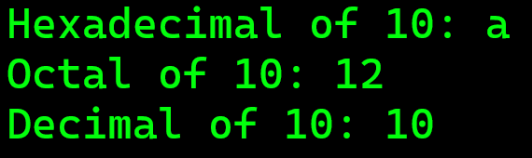
Example to understand \n Manipulator in C++:
#include <iostream>
#include <iomanip>
using namespace std;
int main()
{
cout << "Hello \n Good Afternoon\n";
cout << "Welcome to \n NAST College\n\n";
return 0;
}
Example to understand Integer Manipulator in C++:
#include <iostream> #include <iomanip> using namespace std;
int main()
{
cout << "Hexadecimal of 10: " << hex << 10 <<"\n";
cout << "Octal of 10: " << oct << 10 <<"\n";
cout << "Decimal of 10: " << dec << 10 <<endl<<endl;
return 0;
}
Output:
Output:

Slide 17
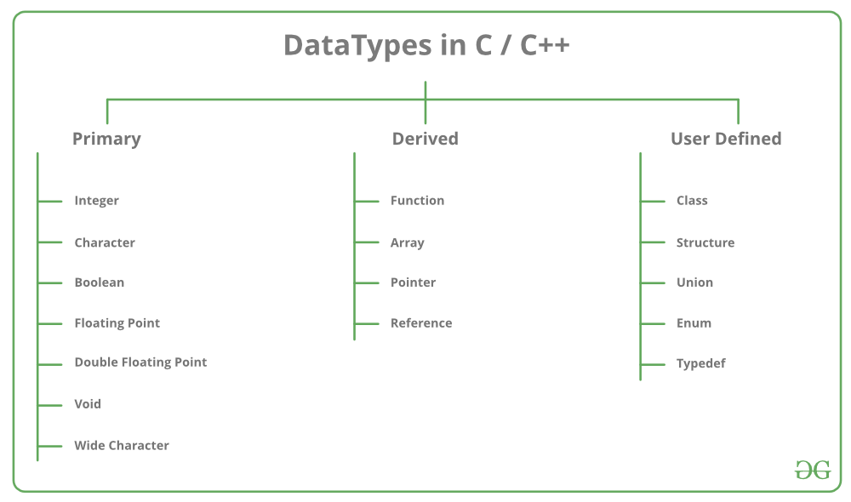
C++ Data Types

Slide 18
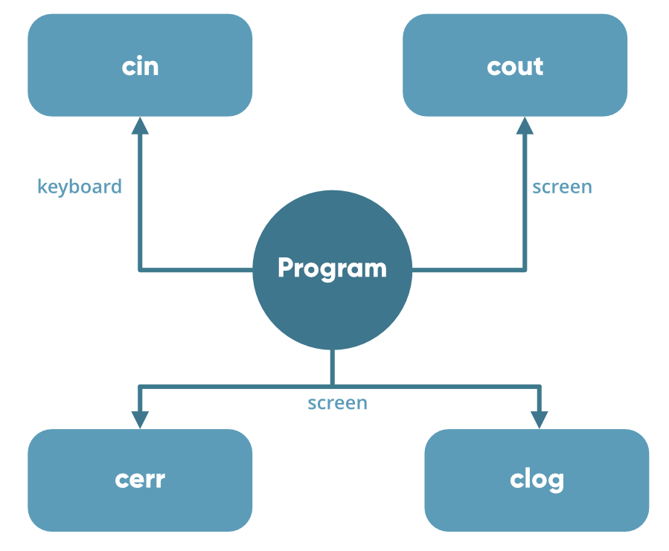
Basic Input / Output in C++

Slide 19
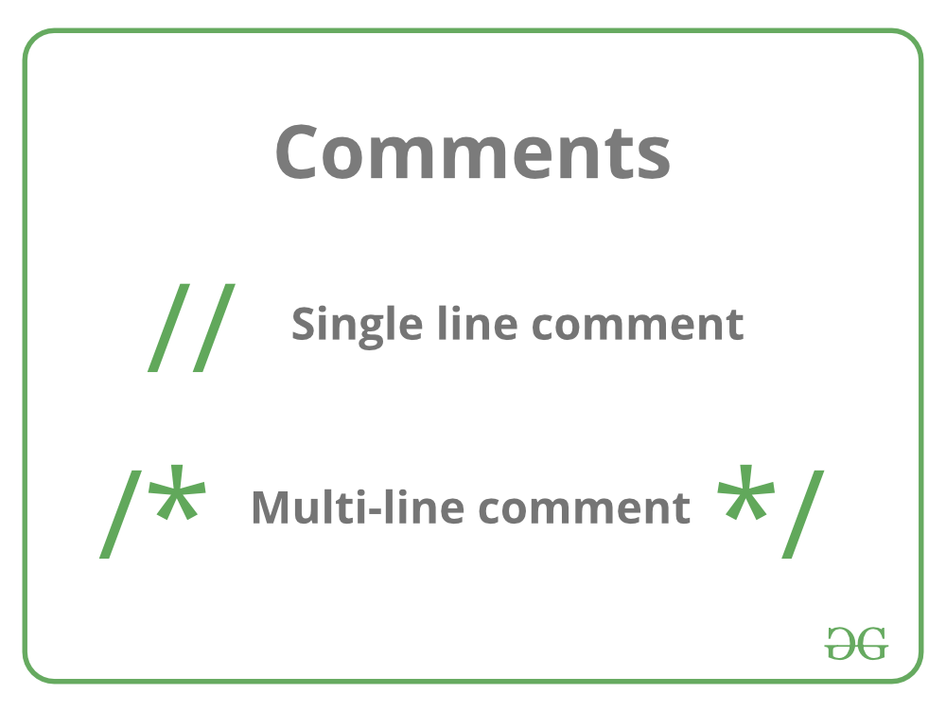
Comments

Slide 20
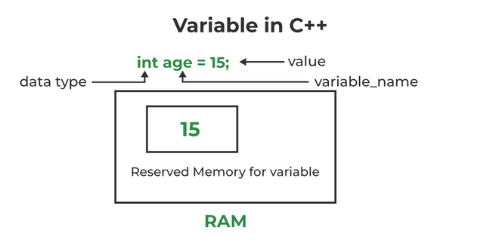
Variables in C++

Slide 21
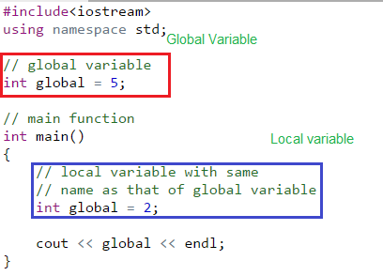
Scope of Variables in C++

Slide 22
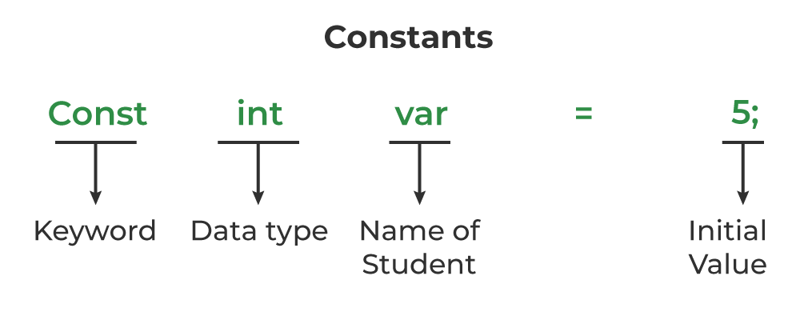
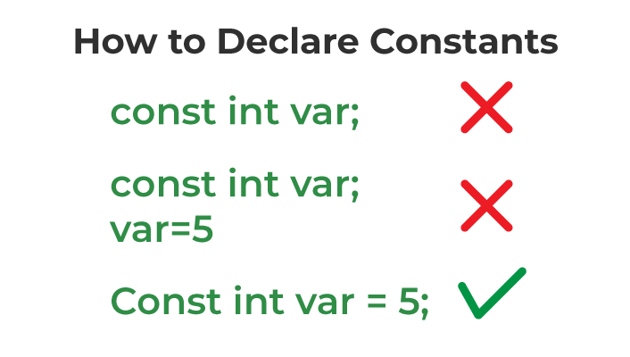

Slide 23
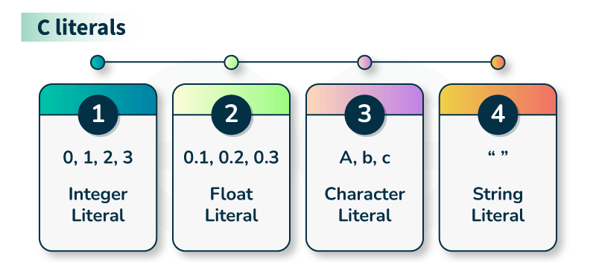
For example, “const int = 5;“
constant expression and the value 5 is referred to as a constant integer literal.

Slide 24
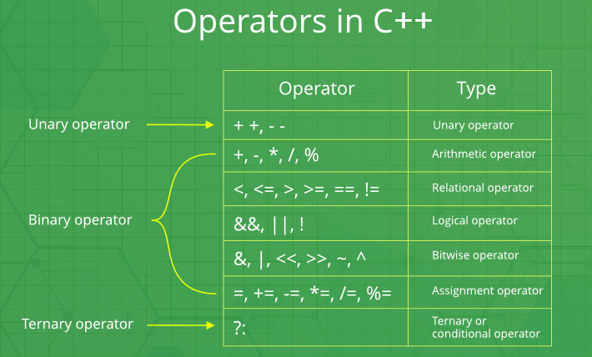

Slide 25
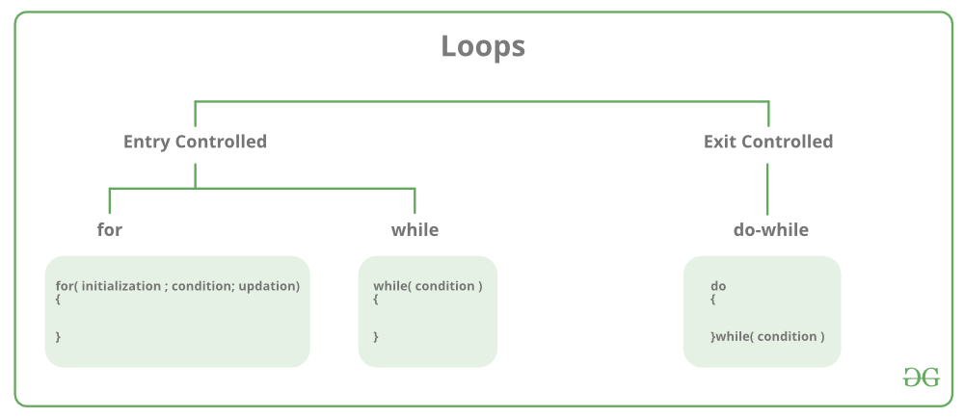
CONTROL FLOW STATEMENTS

Slide 26
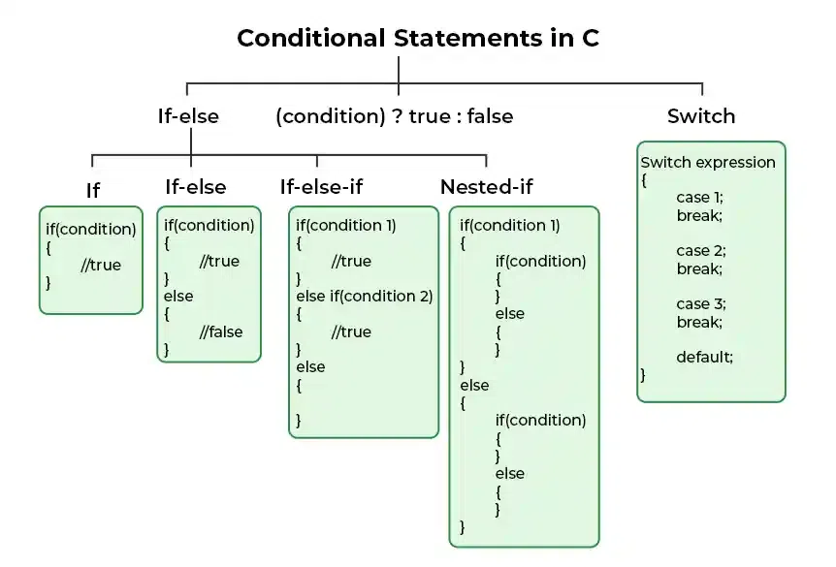

Slide 27
STRUCTURE IN C AND C++
Here's the syntax for defining a structure in C and C++:
struct MyStruct {
// Member variables or fields
dataType1 member1;
dataType2 member2;
// ...
dataTypeN memberN;
};
Differences between C structures and C++ structures:
C structures cannot have member functions, while C++ structures can.
C structures cannot have default values for their members, while C++ structures can.
C structures cannot have static members, while C++ structures can.
C structures cannot have constructors or destructors, while C++ structures can.
C structures cannot have access modifiers, while C++ structures can.

Slide 28
Example: Structure using C
#include <stdio.h>
struct Teacher {
char *name;
int age;
char *subject;
};
int main() {
struct Teacher t;
t.name = “Harendra Bikram Shah";
t.age = 30;
t.subject = "OOP using C++";
printf("Teacher's name is %s\n", t.name);
printf("Teacher is %d years old\n", t.age);
printf("Teacher teaches %s subject\n", t.subject);
return 0;
}
OUTPUT
Teacher’s name is Harendra Bikram Shah
Teacher is 29 Years old
Teacher teaches OOP using C++ Subject

Slide 29
Example: Structure using C++
#include <iostream>
using namespace std;
struct Teacher {
string name;
int age;
string subject;
};
int main() {
Teacher t;
t.name = " Harendra Bikram Shah";
t.age = 30;
t.subject = "OOP using C++";
cout << "Teacher's name is " << t.name << endl;
cout << "Teacher is "<<t.age << " years old" <<endl;
cout << "Teacher teaches " << t.subject << " subject" <<endl;
return 0;
}
OUTPUT
Teacher’s name is Harendra Bikram Shah
Teacher is 29 Years old
Teacher teaches OOP using C++ Subject

Slide 30
EXTENSIONS TO STRUCTURES:
C++ supports all the features of structures as defined in C along with OOP philosophy.
In C++, a structure can have both variables and functions as members.
student A; // C++ declaration
Remember, this is an error in C.
keyword struct can be omitted in the declaration of structure variables
The only difference between a structure and a class in C++ is that, by default, the members of a class are private while, by default, the members of a structure are public

Slide 31
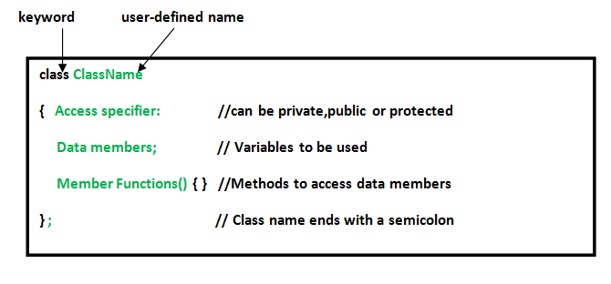
INTRODUCTION TO CLASS AND OBJECT
Class in C++ is the building block that leads to Object-Oriented programming.
A C++ class is like a blueprint for an object.
For Example: Class of Cars.
a class specification has two parts:
Class declaration
Class function definitions/member Functions
A Class is a user-defined data type that has data members and member functions.
Data members are the data variables and member functions are the functions

Slide 32
class class_name
{
private:
variable declarations; function declarations;
public:
variable declarations; function declaration;
}
DECLARING OBJECTS
Syntax
ClassName ObjectName;
Accessing Data Members
accessed using the dot(‘.’) operator with the object.

Slide 33
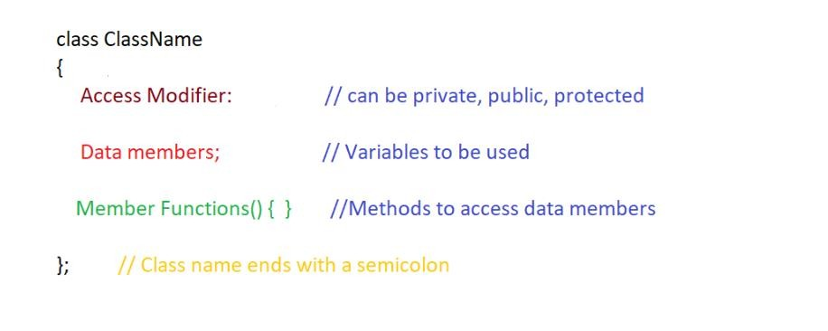

Slide 34
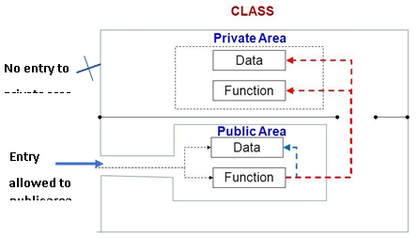

Slide 35


Class Example
class Employee
{
string empName;
int empId;
double empSalary;
public:
void getData(string name, int id, double salary);
void putData(void)
};
Variables declaration private by default
Function declaration using prototype ends with semicolon ;

Slide 36
#include <iostream>
using namespace std;
class Demo {
// Access specifier
public:
// Data Members
string name;
// Member Functions()
void disp()
{
cout << "name is:" << name;
}
};
int main()
{
// Declare an object of class Demo
Demo obj1;
// accessing data member
obj1.name = “Nast";
// accessing member function
obj1.disp();
return 0;
}

Slide 37
MEMBER FUNCTIONS IN CLASSES
There are 2 ways to define a member function: Inside class definition Outside class definition
Outside class definition
The general form of a member function definition is:
Return_type class_name ::function_name (argument declaration)
{
Function body
}

Slide 38
EXAMPLE
#include <iostream>
using namespace std;
class Demo {
// Access specifier
public:
// Data Members
string name1,name2;
// Member Functions()
void disp()
{
cout << "name is:" << name1;
}
void print()
};
void Demo::print()
{
cout<<“another name is”<<name2
}
int main()
{
// Declare an object of class Demo
Demo obj1;
// accessing data member
obj1.name1 = “Nast";
Obj1.name2=“College”;
// accessing member function
obj1.disp();
obj1.print();
return 0;
}

Slide 39
INSIDE THE CLASS DEFINITION:
Another method of defining a member function is to replace the function declaration by the actual function definition inside the class. For example, we could define the item class as follows:
#include <iostream>
using namespace std;
class Demo {
// Access specifier
public:
// Data Members
string name1;
// Member Functions()
void print()
{
cout<<“ name is”<<name1
}
};
int main()
{
// Declare an object of class Demo
Demo obj1;
// accessing data member
obj1.name1 = “Nast";
// accessing member function
obj1.print();
return 0;
}
When a function is defined inside a class, it is treated as an inline function
Normally, only small functions are defined inside the class definition.

Slide 40
EXAMPLE OUTSIDE CLASS
Example: Class Implementation:
#include<iostream>
using namespace std;
class Employee
{
string empName; //private by default
int empId; //private by default
double empSalary; //private by default
public:
void getData(string name, int id, double salary); // prototype declaration
// function defined inside class
void putData(void)
{
cout << "Employee ID: " << empId << endl;
cout << "Employee Name: " << empName << endl;
cout << "Employee Salary: " << empSalary << endl;
}
};

Slide 41
//*************** Member Function Definition ****************
void Employee :: getData(string name, int id, double salary) // Use Membership Label
{
empId = id; // Private variables directly used
empName = name; // Private variables directly used
empSalary = salary; // Private variables directly used
}
//************** Main Program ********************
int main()
{
Employee emp1; // Create object emp1
cout << "\n*********Employee Details*********" << endl << endl;
emp1.getData(“XYZ",11, 50000.60); // Call Member function
emp1.putData(); // Call Member function
return 0;
}

Slide 42
Simple Example 1: Inside the class definition:
#include<iostream>
using namespace std;
class Item {
private:
int number;
float cost;
public:
void getdata()
{
cout << "Enter the Item number" << endl;
cin >> number;
cout << "Enter the cost of item" << endl;
cin >> cost;
}
void display()
{
cout << "Item number=" << number << endl; cout << "Cost of item=" << cost << endl;
}};

Slide 43
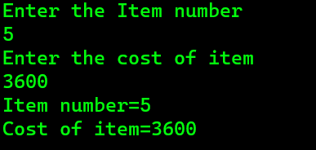
int main()
{
Item x;
x.getdata();
x.display();
return 0;
}
OUTPUT:

Slide 44
Simple Example 2: Outside the class definition:
#include<iostream>
using namespace std;
class Item {
private:
int number;
float cost;
public:
void getdata();
void display();
};
void Item::getdata()
{
cout << "Enter the Item number" << endl; cin >> number;
cout << "Enter the cost of item" << endl; cin >> cost;
}

Slide 45
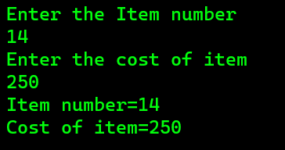
void Item::display()
{
cout << "Item number=" << number << endl;
cout << "Cost of item=" << cost << endl;
}
int main()
{
Item x;
x.getdata();
x.display();
return 0;
}
Output:

Slide 46
Inside Class Definition:
Advantages:
Conciseness: Keeps the class definition concise and self-contained.
Accessibility: Provides easy access to all members, including private ones.
Simplicity: Suitable for small and simple classes, making the code easier to read and understand.
Disadvantages:
Readability and Maintainability: Can become harder to read and maintain as the class grows in size.
Compiling Efficiency: May result in increased compilation time if the class has inline member functions.
Separation of Concerns: Mixes the declaration and implementation code, potentially hindering separation of concerns.

Slide 47
Outside Class Definition:
Advantages:
Separation of Concerns: Allows for clear separation between the class declaration and implementation code, improving code organization and maintainability.
Encapsulation: Encourages encapsulation by explicitly specifying access specifiers and providing public member functions for accessing and modifying private members.
Reusability: Enables easy reuse of the class declaration in multiple files or projects, promoting code modularity.
Disadvantages:
Code Scattering: The class declaration and member function definitions are spread across multiple files, making it more challenging to navigate and understand the implementation.
Access Control: Relies on access specifiers, which can lead to accidental or unintended access if not used consistently or properly.
Increased Complexity: Requires managing and organizing multiple files, which can introduce additional complexity

Slide 48
ARRAY OF OBJECTS
An object of class represents a single record in memory, if we want more than one record of class type, we have to create an array of object.
An array of objects is stored inside the memory in the same way as multidimensional array.
Array of object is used to create an array of similar type of object, we can also create different categories of employee.
Employee hod[3]; // array of hod
Employee accountant[2]; // array of accountant
Employee faculty[25]; // array of faculty

Slide 49
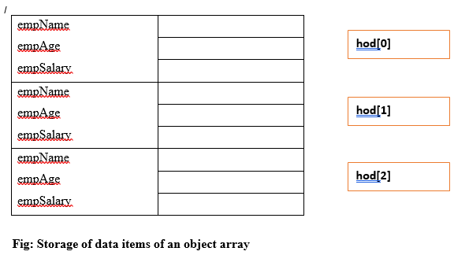
ARRAY OF OBJECTS

Slide 50
Example: of 1 Object
#include<iostream>
using namespace std;
class Employee
{
int id;
char name[30];
public:
void getdata();//Declaration of function
void putdata();//Declaration of function
};
void Employee::getdata(){//Defining of function
cout<<"Enter Id : ";
cin>>id;
cout<<"Enter Name : ";
cin>>name;
}
void Employee::putdata(){//Defining of function
cout<<id<<" ";
cout<<name<<" ";
cout<<endl;
}
int main()
{
Employee emp; //One member
emp.getdata();//Accessing the function
emp.putdata();//Accessing the function
return 0;
}

Slide 51
Example: Array of objects
#include<iostream>
using namespace std;
class Employee
{
int id;
char name[30];
public:
// Declaration of function
void getdata();
// Declaration of function
void putdata();
};
// Defining the function outside the class
void Employee::getdata()
{
cout << "Enter Id : ";
cin >> id;
cout << "Enter Name : ";
cin >> name;
}
// Defining the function outside the class
void Employee::putdata()
{
cout << id << " ";
cout << name << " ";
cout << endl;
}
int main()
{
// This is an array of objects having maximum limit of 30 Employees
Employee emp[30];
int n, i;
cout << "Enter Number of Employees - ";
cin >> n;
// Accessing the function
for(i = 0; i < n; i++)
emp[i].getdata();
cout << "Employee Data - " << endl;
// Accessing the function
for(i = 0; i < n; i++)
emp[i].putdata();
}

Slide 52
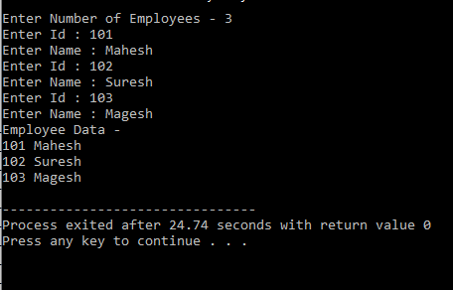
Example: Array of objects

Slide 53
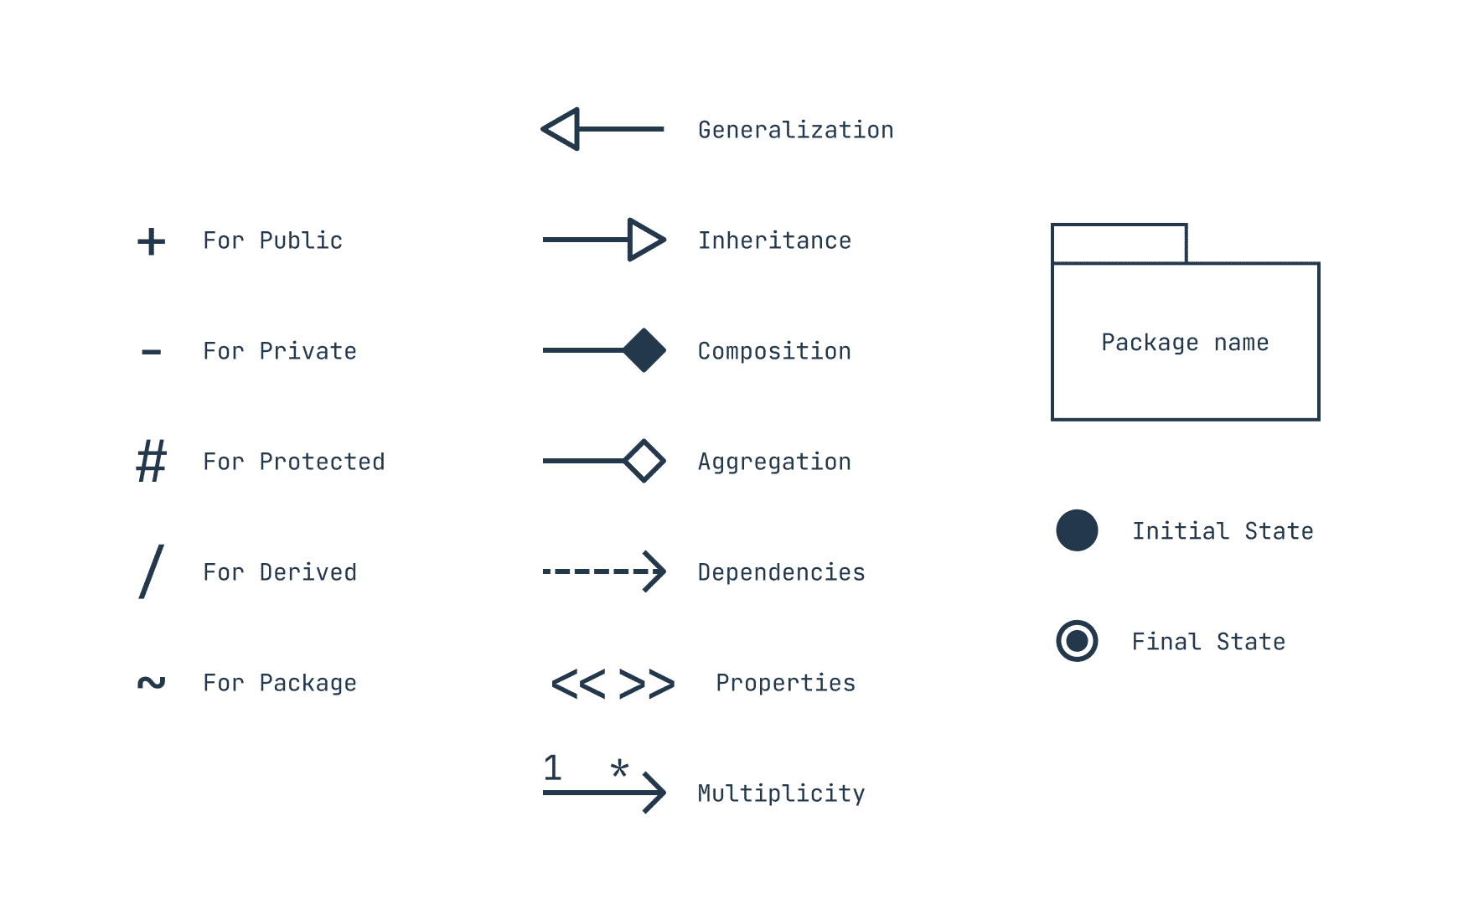
CLASS DIAGRAM AND OBJECT DIAGRAM
Class Diagram shows the structure of a system by representing the system's classes, their attributes, and their relationships.
An object diagram is a UML diagram that shows the instances of a system's classes at a particular point in time.

Slide 54
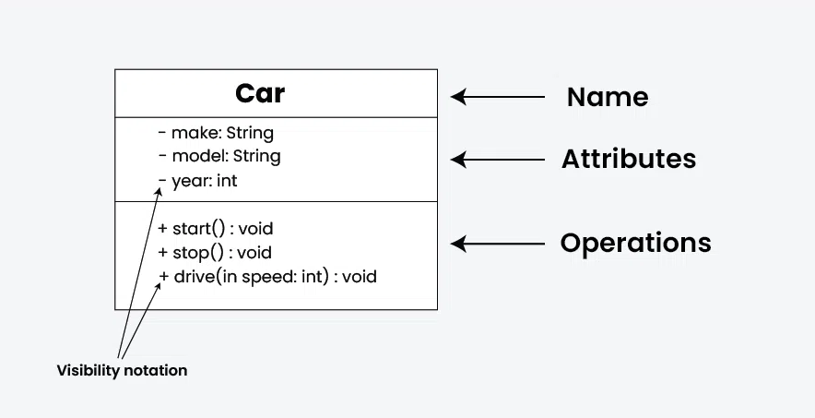
CLASS DIAGRAM AND OBJECT DIAGRAM

Slide 55
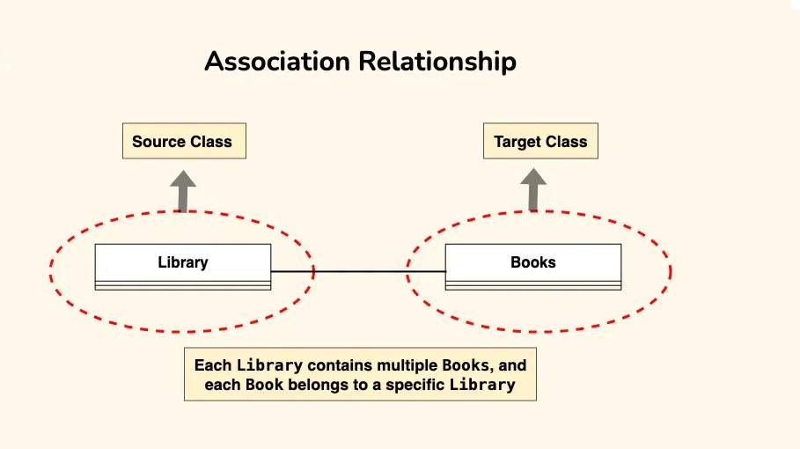
CLASS DIAGRAM AND OBJECT DIAGRAM

Slide 56
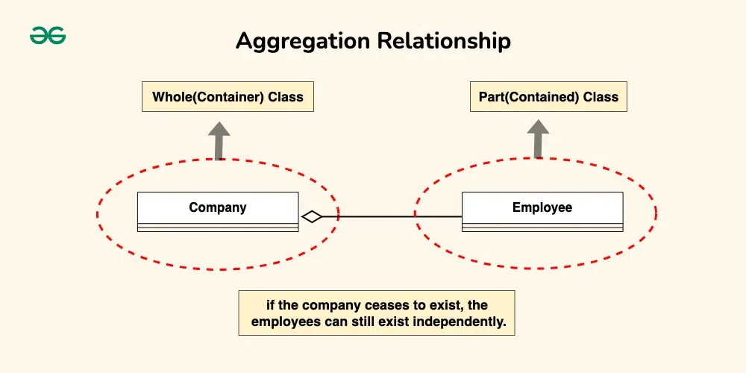
CLASS DIAGRAM AND OBJECT DIAGRAM

Slide 57
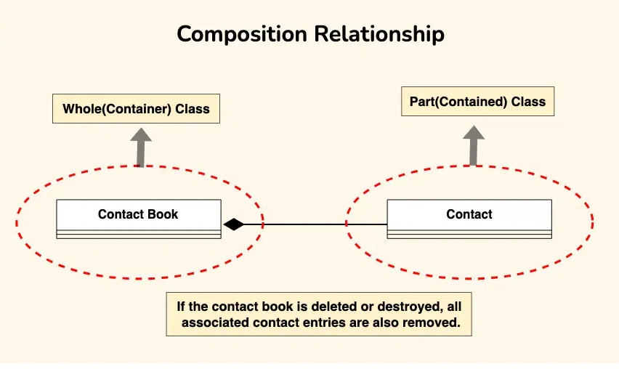
CLASS DIAGRAM AND OBJECT DIAGRAM

Slide 58
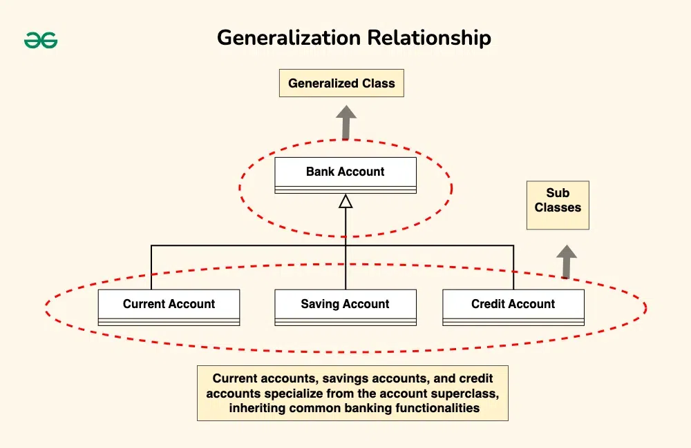
CLASS DIAGRAM AND OBJECT DIAGRAM

Slide 59
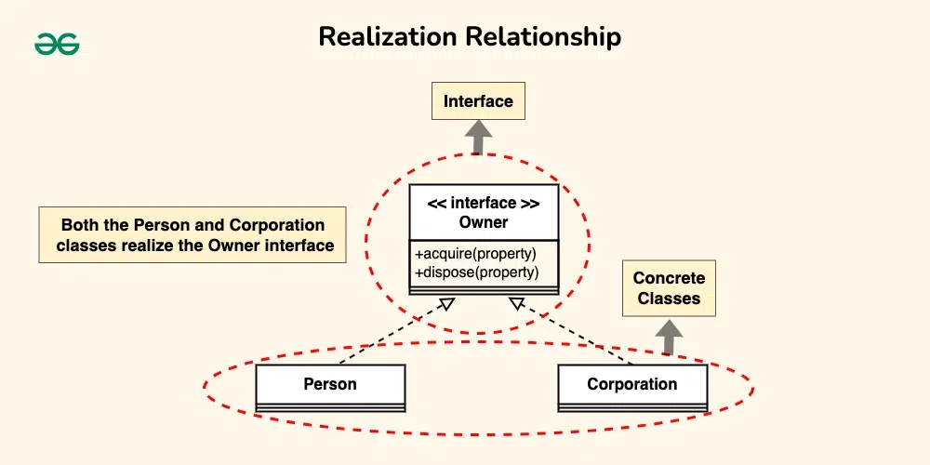
CLASS DIAGRAM AND OBJECT DIAGRAM

Slide 60
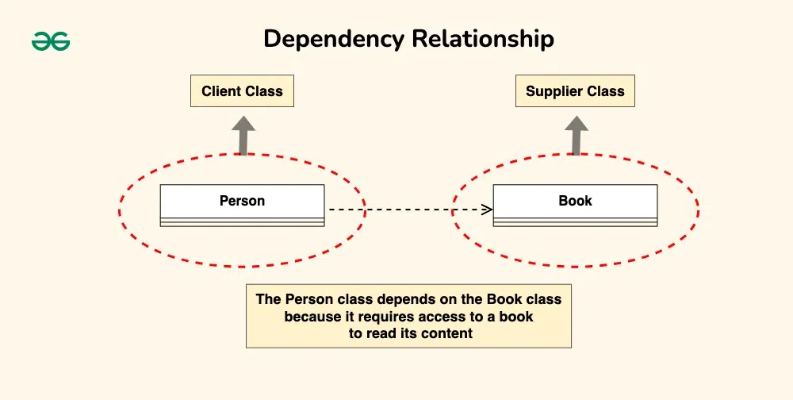
CLASS DIAGRAM AND OBJECT DIAGRAM

Slide 61
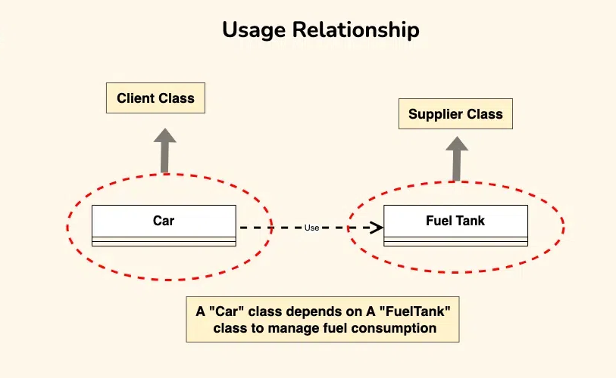
CLASS DIAGRAM AND OBJECT DIAGRAM

Slide 62
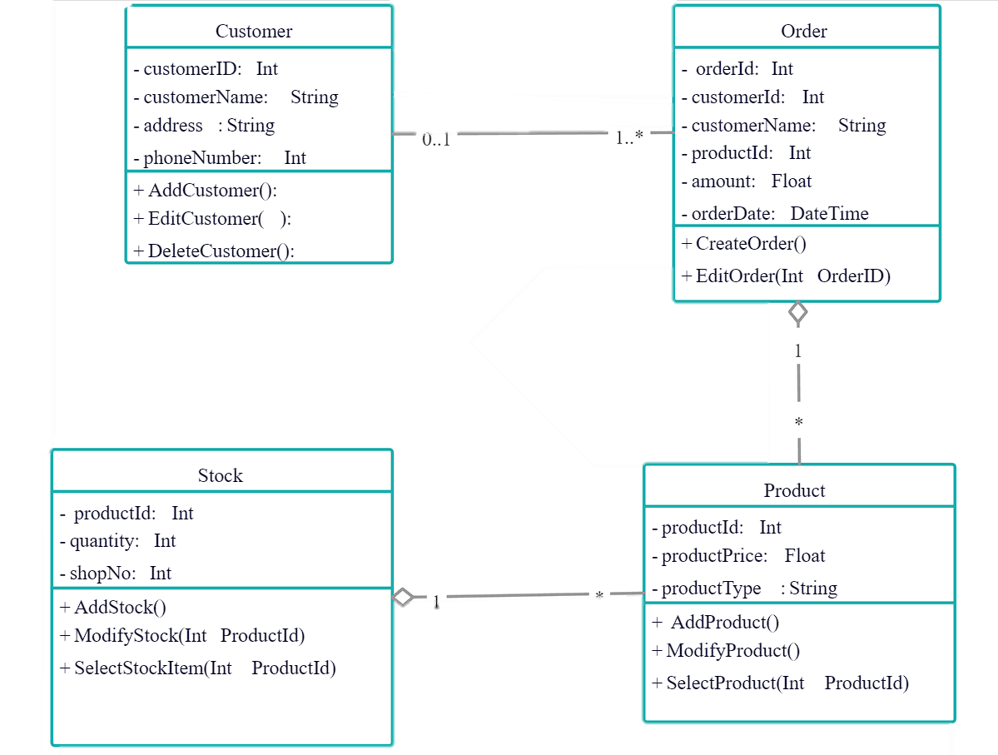
CLASS DIAGRAM

Slide 63
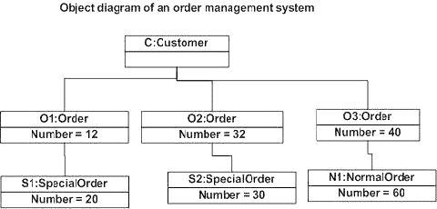
OBJECT DIAGRAM

Slide 64
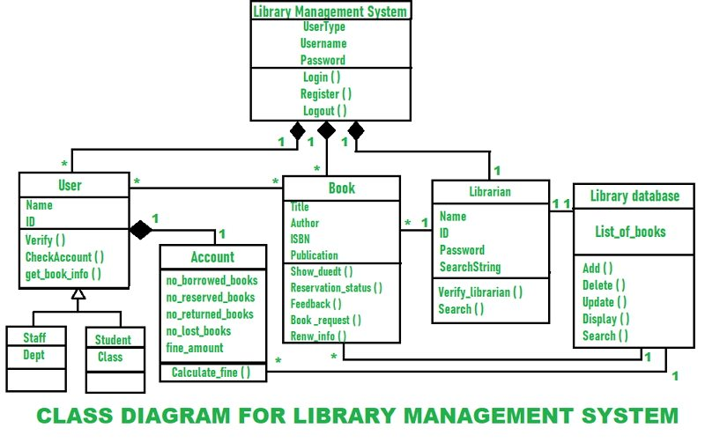

Slide 65
Feature | Class Diagram | Object Diagram
Purpose | Shows the static structure of a system, including classes, attributes, and methods. | Shows a snapshot of the dynamic state of a system at a particular point in time, including objects, their attributes, and their relationships.
Notation | Uses symbols to represent classes, attributes, methods, and relationships. | Uses symbols to represent objects, their attributes, and their relationships.
Example | A class diagram for a banking system might show classes for customers, accounts, and transactions. | An object diagram for a banking system might show a particular customer with a particular account and a particular transaction.

Slide 66

WAP to define the class in C++ as shown in class diagram.
input() : to input initial values
display() : to display the record of students who passed Note:- 45% is pass percentage
Example:
Student
Name : string Roll : int Address : string Percentage : float
+ input() + display()
Student
Name Roll Address Percentage
input() display()
OR
(Question may ask)

Slide 67
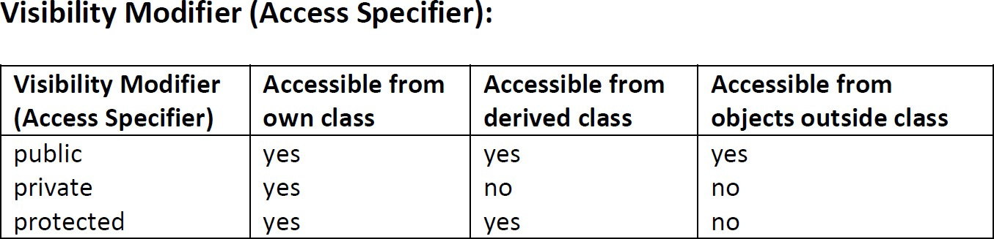
ACCESS SPECIFIERS AND VISIBILITY MODE
There are three access specifiers in C++: public, private, and protected.
Public Access Specifier:
Private Access Specifier:
Protected Access Specifier:

Slide 68
ACCESS SPECIFIERS AND VISIBILITY MODE
Public Access Specifier: #include<iostream>
using namespace std;
class MyClass
{
public:
int publicVar;
void publicMethod()
{
cout << "This is a public method." << endl;
}
};
int main()
{
MyClass obj;
obj.publicVar = 10;
cout << obj.publicVar << endl; // Print the value of publicVar
obj.publicMethod();
return 0;
}

Slide 69
ACCESS SPECIFIERS AND VISIBILITY MODE
Private Access Specifier: #include<iostream>
using namespace std;
class MyClass
{
private:
int privateVar;
void privateMethod()
{
cout << "This is a private method." << endl;
}
public:
void publicMethod()
{
cout << "This is a public method." << endl;
privateVar = 20; // Private member accessed within the class
cout << privateVar << endl; // Print the value of privateVar privateMethod(); // Private method called within the class
}};
int main()
{
MyClass obj; obj.publicMethod();
return 0;
}

Slide 70
ACCESS SPECIFIERS AND VISIBILITY MODE
Protected Access Specifier: #include<iostream>
using namespace std;
class BaseClass
{
protected:
int protectedVar;
void protectedMethod()
{
cout << "This is a protected method." << endl;
}
public:
int getProtectedVar()
{
return protectedVar;
}
};

Slide 71
ACCESS SPECIFIERS AND VISIBILITY MODE
class DerivedClass : public BaseClass
{
public:
void derivedMethod()
{
protectedVar = 30; // Accessing protected member from the derived class
protectedMethod(); // Calling protected method of the base class
}
};
int main() {
DerivedClass obj;
obj.derivedMethod(); // Accessing the protected member through the derived class
cout << obj.getProtectedVar() << endl; // Print the value of protectedVar
return 0;
}

Slide 72
STATE AND BEHAVIOR, METHODS AND RESPONSIBILITIES
State:
State represents the data or variables that an object holds.
These variables define the current condition or attributes of an object.
For example, a "Car" class may have state variables such as "color," "make," "model," and "speed.“
2. Behavior:
Behavior refers to the actions or operations that an object can perform.
These actions can manipulate the state of an object or interact with other objects.
For instance, a "Car" class may have behaviors such as "accelerate," "brake," and "changeGear.“
3. Methods:
Methods are functions associated with a class or object that define its behavior.
In C++, methods are declared within the class definition and can access the object's state variables.
For example, a "Car" class may have methods like "accelerate()" and "brake()" to perform the respective actions.
4. Responsibilities:
Responsibilities represent the tasks or functionalities that an object is responsible for.
These responsibilities define the purpose of the object in the system.
For instance, in a banking system, a "BankAccount" class may have responsibilities such as "deposit," "withdraw," and "getBalance."

Slide 73
STATE AND BEHAVIOR, METHODS AND RESPONSIBILITIES
#include <iostream>
using namespace std;
class Car
{
private:
string color;
string make;
string model;
int speed = 0;
public:
void setColor(const string newColor)
{
color = newColor;
}
void setMake(const string newMake)
{
make = newMake;
}
void setModel(const string newModel)
{
model = newModel;
}
void accelerate(int amount)
{
speed = speed + amount;
}
void brake(int amount)
{
speed = speed-amount;
if (speed < 0)
speed = 0;
}
void printInfo()
{
cout << "Car Information: "
<< "Color: " << color << ", “
<< "Make: " << make << ", "
<< "Model: " << model << ", "
<< "Speed: " << speed << " km/h" << endl;
}};

Slide 74
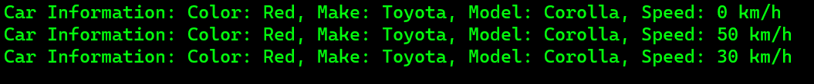
STATE AND BEHAVIOR, METHODS AND RESPONSIBILITIES
int main()
{
Car myCar;
myCar.setColor("Red"); myCar.setMake("Toyota"); myCar.setModel("Corolla");
myCar.printInfo();
myCar.accelerate(50); myCar.printInfo();
myCar.brake(20); myCar.printInfo();
return 0;
}
OUTPUT

Slide 75
Implementation of Data Abstraction, Encapsulation, Message Passing and Data Hiding
Data Abstraction:
allows us to hide the internal details of a class and provide only essential information to the outside world.
#include <iostream>
using namespace std;
class Rectangle
{
private:
int length; int width;
public:
void setDimensions(int L, int W)
{
length = L;
width = W;
}
int getArea()
{
return length * width;
}};
int main() {
Rectangle rect; rect.setDimensions(5, 3); int area = rect.getArea();
cout << "Area: " << area << endl;
return 0;
}

Slide 76
Implementation of Data Abstraction, Encapsulation, Message Passing and Data Hiding
Encapsulation:
allows us to bundle data and method that operate on that data into a single unit
#include <iostream> using namespace std;
Class Car
{
private:
string brand;
string model;
int year;
public:
// Setter methods
Void setBrand(string b)
{
brand = b;
}
void setModel(string m)
{ model = m;
}
void setYear(int y)
{
year = y;
}

Slide 77
// Getter methods
string getBrand()
{
return brand;
}
string getModel()
{
return model;
}
int getYear()
{
return year;
}
};
int main()
{
Car myCar;
// Set the car details using setter methods
myCar.setBrand("Toyota");
myCar.setModel("Camry");
myCar.setYear(2020);
// Get and display the car details using getter methods
cout << "Brand: " << myCar.getBrand() << endl;
cout << "Model: " << myCar.getModel() << endl;
cout << "Year: " << myCar.getYear() << endl;
return 0;
}

Slide 78
Implementation of Message Passing:
Message passing is a way for objects to communicate with each other in C++.
Synchronous message :Blocking way
Asynchronous message: Unblocking way
#include<iostream> using namespace std; class Car {
public:
void Drive() {
cout << "The car is driving." << endl;
}
};
class Person
{
public:
void DriveCar(Car &car)
{ car.Drive();
}};
int main() {
Car car;
Person person;
person.DriveCar(car); return 0;
}

Slide 79
Implementation of Data Hiding:
Data hiding in C++ is typically achieved using the concept of access specifiers.
Public: Public members are accessible from anywhere, both inside and outside the class.
Private: Private members are only accessible from within the class. They are hidden from the outside world.
Protected: Protected members are similar to private members, but they are also accessible by derived classes
class MyClass { private:
int privateData; // private member variable
public:
int publicData; // public member variable
private:
void privateMethod() {
cout<<"I am Hiding my Data"<<endl;
// private member function
}

Slide 80
public:
void publicMethod()
{
cout<<"I am showing my Data"<<endl;// public member function
}
};
int main()
{
MyClass obj;
obj.publicData = 10; // accessing publicData cout<<obj.publicData<<endl;
obj.publicMethod(); // calling publicMethod
// The following statements will result in compilation errors:
// obj.privateData = 20; // accessing privateData (error)
// obj.privateMethod(); // calling privateMethod (error)
return 0;
}

Slide 81
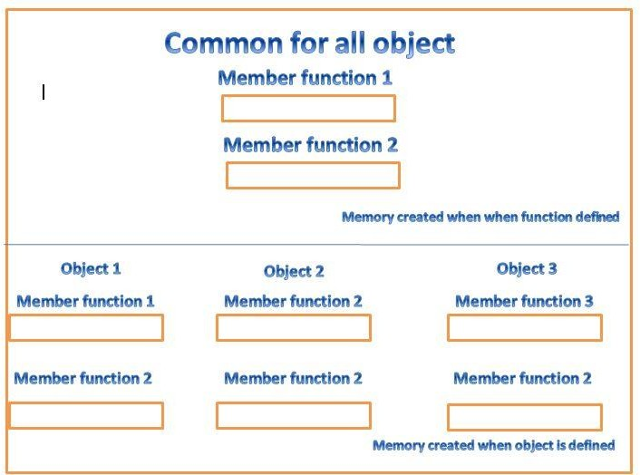
MEMORY ALLOCATIONS FOR OBJECTS
refers to the process of reserving memory in a computer's memory space to store the data and state of an object

Slide 82
MEMORY ALLOCATIONS FOR OBJECTS
In C++, memory allocation for objects can be classified into two main categories: stack allocation and heap allocation.
Stack Allocation:
Stack allocation involves reserving memory on the stack, which is a region of memory managed by the compiler.
When an object is allocated on the stack, the memory is automatically allocated and deallocated as the object goes in and out of scope.
Stack allocation is generally faster and has less overhead compared to heap allocation.
It is the default and preferred way for most objects in C++.
Here's an example of stack allocation:
void function()
{
int x = 5; // stack-allocated integer
// ...
} // x is deallocated automatically when function() returns

Slide 83
MEMORY ALLOCATIONS FOR OBJECTS
Heap Allocation:
Heap allocation involves reserving memory on the heap, which is a larger region of memory used for dynamic memory allocation.
When an object is allocated on the heap, memory is allocated using the new operator, and it remains allocated until it is explicitly deallocated using the delete operator.
Heap-allocated objects have a longer lifespan and need to be manually managed.
Here's an example of heap allocation:
void function()
{
int* ptr = new int; // heap-allocated integer
// ...
delete ptr; // deallocate the memory
}
use delete[] to deallocate it properly:
void function() {
int* arr = new int[10]; // heap-allocated array of integers
// ...
delete[] arr; // deallocate the array
}

Slide 84
CONSTRUCTOR: DEFAULT CONSTRUCTOR, PARAMETERIZED CONSTRUCTOR, COPY CONSTRUCTOR
A constructor is a special member function in object-oriented programming languages.
It is called automatically when an object is created.
Primary Purpose initializing the data members of the class
allocating resources if needed
performing any necessary setup operations.
The constructor is automatically executed whenever an object is created.
It is called constructor because it constructs values of data members of a class.

Slide 85
CONSTRUCTOR
How constructor differ from normal member function:
Constructors differ from normal member functions in several ways:
Name and Return Type: name same as class name with no return types
Automatic Invocation: Constructors are automatically invoked when an object is created.
Initialization: Constructors are primarily used to initialize the data members of a class and set up the object's initial state.
Parameters: Constructors can have parameters or no parameters at all.
Multiple Constructors: A class can have multiple constructors with different parameter lists with same name.
Destructor: to destroy constructor mandatory needed or goes out of scope
In summary,
Constructor has same name as the class name.
Constructor don’t have return type.
A constructor is automatically called when an object is created.
Constructor can be declared in the public section.
If we do not specify a constructor, C++ compiler generate a default constructor for us
(expects no parameters and has an empty body).

Slide 86
Rules for Constructor:
The constructor has the same name as the class.
The constructor does not have a return type, and
Constructor is public
Constant keyword cannot be used for constructor
Default Constructors
Parameterized Constructors
Copy Constructors
The syntax for defining constructor inside the class body and outside the class body :
class CLASSNAME
{
………
public :
CLASSNAME([parameter_list]) // constructor definition
{
. . . . . .
}
. . . . . . . .
};
class CLASSNAME
{
. . . . . . . .
public:
CLASSNAME ([parameter_list]);//Constructor declaration
. . . . . . . . .
};
CLASSNAME: :CLASSNAME([parameter_list])//Constructor Definition
{
. . . . . . . . . . .
}

Slide 87
DEFAULT CONSTRUCTOR
A constructor with no parameters.
class CLASS_NAME
{
public:
class_name() //Default constructor declared.
{
}
};
#include<iostream>
class Demo {
public:
int a;
//default constructor
Demo()
{
a=30;
cout<<“the value of a is:"<<a;
}};
int main()
{
//default constructor called when object is created
Demo obj;
return 0;
}

Slide 88
PARAMETERIZED CONSTRUCTOR
Constructors that can take arguments are known as parameterized constructors.
class CLASS_NAME
{
public:
CLASS_NAME(variables) //Parameterized constructor declared.
{
}
};
class CLASS_NAME
{
};
CLASS_NAME :: CLASS_NAME(variables) //Parameterized constructor declared.
{
}

Slide 89
#include <iostream>
using namespace std;
class Demo
{
private:
int a, b;
public:
// Parameterized Constructor
Demo(int a1, int b1)
{
a = a1;
b = b1;
Cout<<“the value of a and b is:”<<a<<“ ”<<b<<endl;
}
};
int main()
{
// Calling the constructor
Demo obj1(5, 10);
return 0;
}

Slide 90
COPY CONSTRUCTOR
A copy constructor is a member function that initializes an object using another object of the same class.
Syntax:
class-name (class-name &ref)
{
//Block of Statements;
}
Demo(Demo &obj)
{
a= obj.a;
b= obj.b;
}
void disp()
{
return a * b;
}
};
int main() {
// create an object of Demo class
Demo obj1(5,6);
// copy contents of obj1 to obj2
Demo obj2 = obj1;
// displaying
cout << “product of obj1: " << obj1.disp() << endl;
cout << “product of obj2: " << obj2.disp();
return 0;
}
#include <iostream>
using namespace std;
// declare a class
class Demo {
private:
int a,b;
public:
// initialize variables with parameterized constructor
Demo(int p, int q) {
a=p;
b=q;
}
// copy constructor with a Demo object as parameter
// copies data of the obj parameter

Slide 91
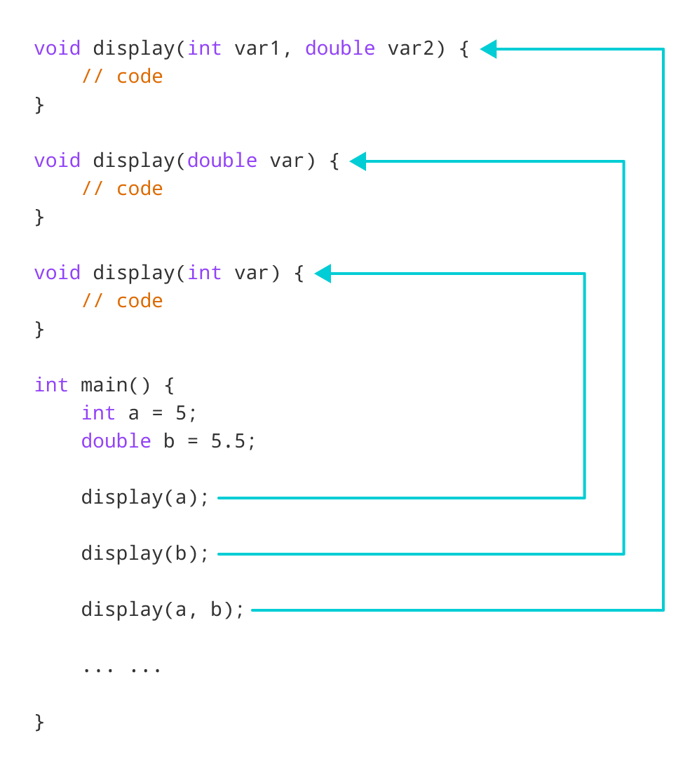
OVERLOADING CONSTRUCTOR
constructor in a class which are more than one with same name with different list of arguments.
This enables you to create objects using different sets of arguments or initialize objects in different ways.

Slide 92
OVERLOADING CONSTRUCTOR
#include <iostream>
using namespace std;
class Democonstruct
{
public:
float area;
// Constructor with no parameters
Democonstruct()
{
area = 0;
}
// Constructor with two parameters
Democonstruct(int a, int b)
{
area = a * b;
}
void disp()
{
cout<< area<< endl;
}
};
int main()
{
// Constructor Overloading
// with two different constructors
// of class name
Democonstruct obj1;
Democonstruct obj2( 10, 20);
obj1.disp();
obj2.disp();
return 1;
}

Slide 93
DESTRUCTOR
In C++, destructors are special member functions of a class that are used to clean up resources and perform necessary actions before an object of that class is destroyed or goes out of scope.
They have the same name as the class, preceded by a tilde (~).
Here's the general syntax of a destructor in C++:
class ClassName { public:
// Constructor(s) and other member functions
// Destructor
~ClassName() {
// Clean up resources and perform necessary actions
}
};

Slide 94
DESTRUCTOR
Key points to note about destructors:
Destructors do not have return types, not even void.
A class can have only one destructor, and it cannot be overloaded with different parameters.
Destructors are automatically called when an object goes out of scope.
Destructors are called in the reverse order of object creation.
Destructors can be useful for releasing dynamically allocated memory, closing file handles, freeing resources, or performing any necessary cleanup actions before an object is destroyed.

Slide 95
// C++ program to demonstrate the execution of constructor
// and destructor
#include <iostream>
using namespace std;
class Test {
public:
// User-Defined Constructor
Test()
{
cout << "\n Constructor executed";
}
// User-Defined Destructor
~Test()
{
cout << "\nDestructor executed";
}
};
main()
{
Test t;
return 0;
}

Slide 96
DYNAMIC MEMORY ALLOCATION: NEW AND DELETE
Dynamic memory allocation in C++ allows you to allocate memory at runtime and manage it manually using the new and delete operators.
The new operator: It is used to allocate memory for a single object dynamically. The general syntax is:
pointer_variable = new data_type;
For example, to allocate memory for an integer dynamically:
int* ptr = new int;
2. The delete operator: It is used to deallocate memory that was allocated using new. The general syntax is:
delete pointer_variable;
For example, to deallocate the memory allocated for the integer pointer ptr:
delete ptr;
This statement frees the memory previously allocated using new.

Slide 97
DYNAMIC MEMORY ALLOCATION: NEW AND DELETE
3. Dynamic memory allocation for arrays: We can allocate memory for arrays dynamically using new[] and deallocate it using delete[].
The syntax is as follows:
pointer_variable = new data_type[size];
For example, to allocate memory for an array of integers dynamically:
int* arr = new int[5];
To deallocate the memory for the array:
delete[] arr;
This statement frees the memory previously allocated for the array using new[].

Slide 98
DYNAMIC MEMORY ALLOCATION: NEW AND DELETE
Example DMA in C++:
#include <iostream>
using namespace std;
int main()
{
// Dynamic memory allocation for a single integer
int* ptr = new int; // Allocate memory for an integer
*ptr = 42; // Assign a value to the dynamically allocated integer
cout << "Dynamically allocated integer: " << *ptr<< endl;
delete ptr; // Deallocate the memory
// Dynamic memory allocation for an array of integers
int size = 5;
int* arr = new int[size]; // Allocate memory for an array of integers
for (int i = 0; i < size; i++)
{
arr[i] = i * 10; // Assign values to the elements of the array
}
cout << "Dynamically allocated array: ";

Slide 99

DYNAMIC MEMORY ALLOCATION: NEW AND DELETE
for (int i = 0; i < size; i++) {
cout << arr[i] << " "; // Print the elements of the array
}
cout << endl;
delete[] arr; // Deallocate the memory for the array
return 0;
}
Output:

Slide 100

DYNAMIC CONSTRUCTOR
When allocation of memory is done dynamically using dynamic memory allocator new in a constructor, it is known as dynamic constructor.
By using this, we can dynamically initialize the objects.
Example: Basic Dynamic Constructor
#include<iostream> using namespace std;
class Basic
{
int *a; public:
Basic()
{
a=new int;
*a=10;
}
void display()
{
cout<<"The value of a = "<< *a<<endl;
}
};
int main()
{
Basic obj; obj.display();
}
Output:

Slide 101
DYNAMIC CONSTRUCTOR
When allocation of memory is done dynamically using dynamic memory allocator new in a constructor, it is known as dynamic constructor.
By using this, we can dynamically initialize the objects.
Example: Basic Dynamic Constructor
#include<iostream> using namespace std;
class Basic
{
int *a; public:
Basic()
{
a=new int;
*a=10;
}
void display()
{
cout<<"The value of a = "<< *a<<endl;
}
};
int main()
{
Basic obj; obj.display();
}
Output:

Slide 102
Functions: Inline Function, Default argument, Passing and Returning Value, Pointer and Reference, Static Data Member and Static Member Function
Inline Function:
Type of function that is expanded in-line at the point of its call, rather than invoking a function call.
It is typically used for small, frequently executed functions.
To declare a function as inline, you can use the inline keyword before the function declaration.
Default Argument:
value provided in the function declaration that is automatically used
It provide a default value for one or more function parameters, making those parameters optional.
Default arguments are specified in the function declaration, typically in the function prototype.
Passing and Returning Value:
providing input values (arguments) to the function during its invocation.
Return is used to return the value.

Slide 103
Functions: Inline Function, Default argument, Passing and Returning Value, Pointer and Reference, Static Data Member and Static Member Function
Pointer and Reference:
Pointers and references are used to manipulate and work with memory locations in C++.
Pointers: A pointer is a variable that stores the memory address of another variable.
Pointers are declared using the * operator.
References: A reference is an alternative name for an existing variable.
Unlike pointers, references cannot be reassigned to point to a different variable.
References are declared using the & operator.
Static Data Member and Static Member Function:
Static Data Member:
In C++, a static data member is a member of a class that is shared by all instances (objects) of the class.
We can’t initialized it in the class definition but it can be initialized outside the class using the scope resolution operator :: to identify which class it belongs to.
All static data is initialized to zero (because its default value is zero) when first object is created
Static Member Function:
A static member function is a function that belongs to the class rather than the objects of the class.
It can be invoked using the class name without creating an object of the class.
Since it doesn't have access to the object-specific data members, it can only access static data members and other static member functions.

Slide 104

EXAMPLES
Inline Function: #include <iostream>
using namespace std; // Inline function declaration inline int add(int a, int b)
{
return a + b; }
int main()
{ int result = add(5, 3); // Function call
cout << "Result: " << result << endl; return 0; }
Output:

Slide 105
EXAMPLES
Default Argument: #include <iostream>
using namespace std;
// Function declaration with default argument void greet(string name = "Anonymous")
{
cout << "Hello, " << name << "!" << endl; }
int main()
{ greet(); // Using the default argument greet("NAST"); // Providing a custom argument return 0; }
OUTPUT
Hello Anonymous
Hello NAST

Slide 106
EXAMPLES
Passing and Returning Value: #include <iostream>
using namespace std; // Function that calculates the sum of two numbers and returns the result int add(int a, int b)
{
return a + b; } // Function that prints the result of adding two numbers
void printSum(int a, int b)
{
int sum = add(a, b); // Function call and assigning the return value to a variable
cout << "Sum: " << sum << endl;
}
int main()
{
printSum(10, 20); // Function call
return 0;
}

Slide 107
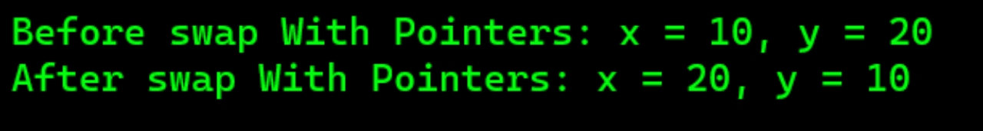
EXAMPLES
Pointer Swapping: #include <iostream>
using namespace std; // Function that swaps the values of two integers using pointers void swapWithPointers(int *a, int *b)
{
int temp = *a; *a = *b; *b = temp; } int main()
{ int x = 10, y = 20; cout << "Before swap With Pointers: x = " << x << ", y = " << y << endl; // Swap using pointers swapWithPointers(&x, &y); cout << "After swap With Pointers: x = " << x << ", y = " << y << endl; return 0; }
Output:

Slide 108

EXAMPLES
Reference Swapping: #include <iostream>
using namespace std; // Function that swaps the values of two integers using references void swapWithReferences(int &a, int &b)
{
int temp = a; a = b; b = temp; }
int main()
{ int x = 10, y = 20;
cout << "Before swap With References: x = " << x << ", y = " << y << endl; // Swap using references swapWithReferences(x, y); cout << "After swap With References: x = " << x << ", y = " << y << endl; return 0; }
Output:

Slide 109
Static Data Member and Static Member Function
Static data members are class members that are declared using static keywords.
Rules for Static Data Member:
Static Data member are initialized to Zero initially.
Only one copy of that member is created for the entire class and is shared by all the objects of that class, no matter how many objects are created.
It is initialized before any object of this class is created, even before the main starts.
It is visible only within the class, but its lifetime is the entire program.
Syntax:
static data_type data_member_name;

Slide 110
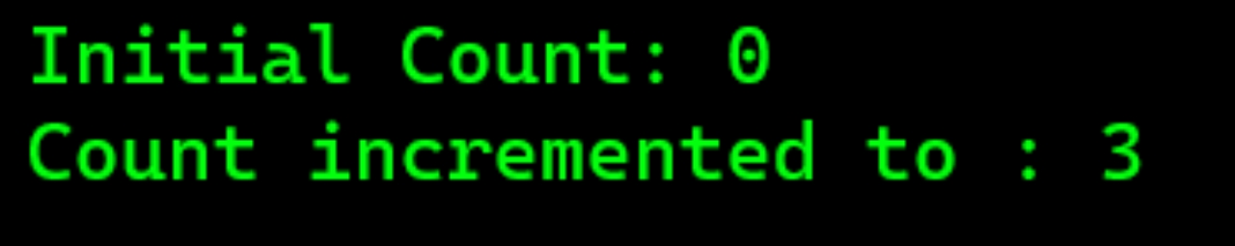
#include<iostream>
using namespace std; class StaticData { public: int a; static int count; StaticData() { count++; } }; int StaticData::count=0; int main() { cout<<"Initial Count: "<<StaticData::count<<endl;
StaticData obj1,obj2,obj3; //default constructor is called cout<<"Count incremented to : "<<StaticData::count<<endl; return 0; }
Output:

Slide 111




10
20
30
3
(Common to all three) Figure: Sharing of a static data

Slide 112
Static Data Function
Member function that is defined by using static keyword within the class is knows as Static Data Function.
A static member function can be called even if no objects of the class exist T
The static functions are accessed using only the class name and the scope resolution operator ::
A static member function can only access static data member, other static member functions and any other functions from outside the class.
#include <iostream>
using namespace std;
class StaticDatamemDemo{
private:
int l;//instance variable
static int b;//static data member
public:
static void setdata(int breadth)//static member function definition
{
b=breadth;
cout<<"the breadth is"<<b<<endl;
}
};
int StaticDatamemDemo::b;
int main()
{
StaticDatamemDemo::setdata(7);//static member function accessing
return 0;
}

Slide 113
FRIEND CLASS AND FRIEND FUNCTION
Function that can access private and protected members of other classes in which it is declared as a friend.
It is sometime called as friendly class.
Syntax:
friend class class_name; // declared in the base class
Eg: friend class b;
class B {
public:
void display(A &t)
{
cout<<"the volume is:"<<t.l*t.b*t.h<<endl;
}
};
// Driver code
int main()
{
A obj1;
obj1.setdata(5,4,2);
B obj2;
obj2.display(obj1);
return 0;
}
#include <iostream>
using namespace std;
class A{
private:
int l,b;protected:
int h;
public: void setdata(int length,int breadth,int height)
{
l=length;b=breadth;h=height;
}
// friend class declaration
friend class B;
};
// Here, class B is declared as a friend inside class A. Therefore,B is a friend of class A. Class B can access the private members of class A.

Slide 114
FRIEND FUNCTION
special function which can access to private and protected members of a class in C++.
A friend function can be:
A global function
A member function of another class
Syntax:
friend return_type function_name (arguments); // for a global function
or
friend return_type class_name::function_name (arguments); // for a member function of another class

Slide 115
EXAMPLE OF FRIEND FUNCTION
EXAMPLE OF GLOBAL FRIEND FUNCTION
#include <iostream>
using namespace std;
class A{
private:
int l,b;
protected:
int h;
public:
void setdata(int length,int breadth,int height)
{
l=length;
b=breadth;
h=height;
}
// friend function declaration
friend void demo(A &t);
};
// Here, function demo is declared as a
// friend function in class A. Therefore,
// demo function is a friend function of class A.
//demo function can access the private members of class A.
void demo(A &t)
{
cout<<"the volume is:"<<t.l*t.b*t.h<<endl;
}
// Driver code
int main()
{
A obj1;
obj1.setdata(5,4,2);
demo(obj1);
return 0;
}

Slide 116
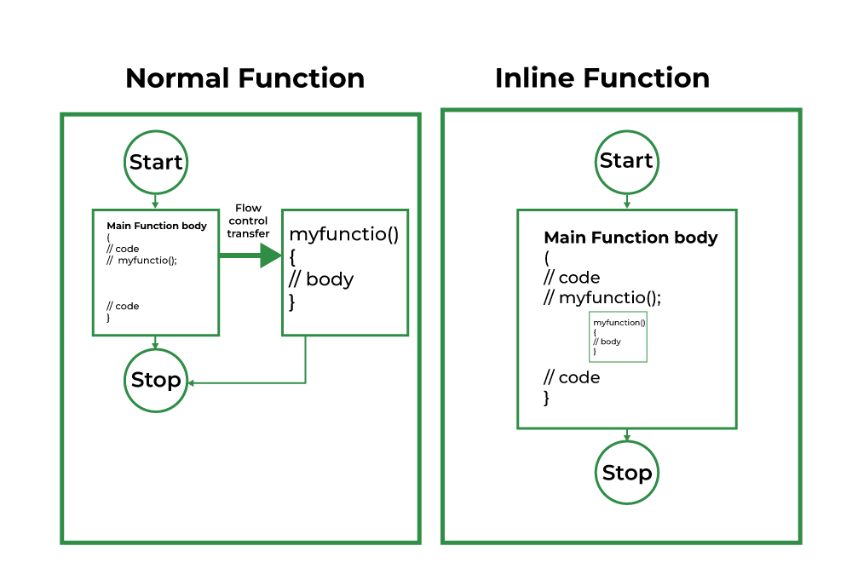
INLINE FUNCTION
An inline function is a function that is expanded in line when it is called.
When the inline function is called whole code of the inline function gets inserted or substituted at the point of the inline function call.
Syntax:
inline return-type function-name(parameters)
{ // function code
}

Slide 117
this POINTER
In C++ programming, this is a keyword that refers to the current instance of the class.
There can be 3 main usage of this keyword in C++.
When local variable’s name is same as member’s name
To return reference to the calling object
#include<iostream>
using namespace std;
/* local variable is same as a member's name */
class Test
{
private:
int x;
public:
void setX (int x)
{
// The 'this' pointer is used to retrieve the object's x
// hidden by the local variable 'x'
this->x = x;
}
void print()
{
cout << "x = " << x << endl;
}};
int main()
{
Test obj;
obj.setX(x);
obj.print();
return 0;
}

Slide 118
End of Unit 2

